Slide 1
Note to teacher:
When printing the station signs found here, you may want to consider printing the “Present Day/ After Human Interference” signs on the back of the “6000 years ago/ Before Human Interference” signs.
This may make it easier to transition from Round 1 to Round 2, as you only need to flip over the sign.
The pony beads are fun, colorful, but optional supplies. While they make an excellent visual, you can conduct the activity without them if you do not have the resources.

Slide 2
THE CARBON CYCLE
Aim: Where on Earth does carbon go?

Slide 3
Do Now
True or False?
An element formed deep inside stars is the basis for all life on earth, was used in the first primitive tattoos and can take the form of the graphite in your pencil, a piece of coal, or a diamond in jewelry?

Slide 4
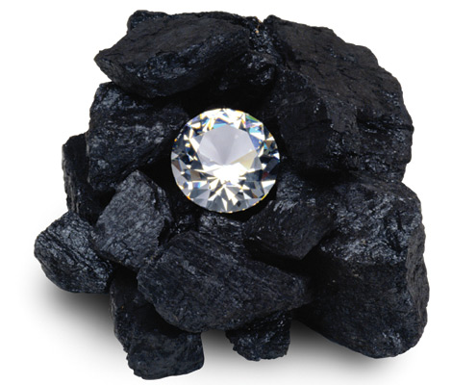
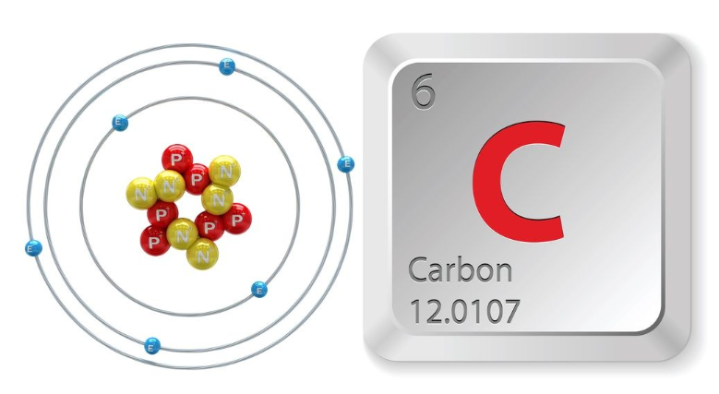
True!

Slide 5
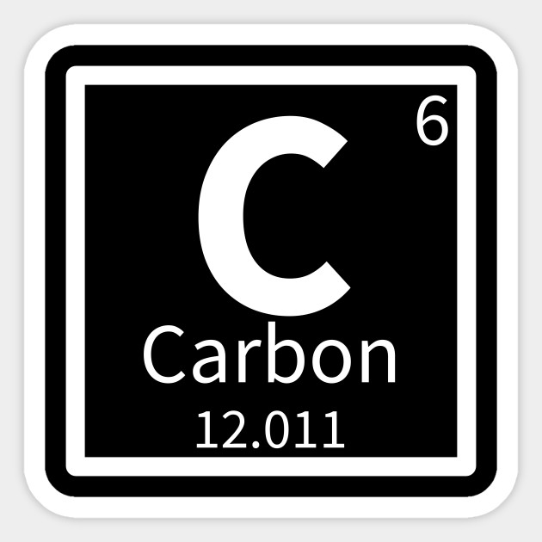
Carbon
Atomic element
Needed for all life on earth.
Can take many forms

Slide 6
Carbon Cycle
Carbon re-cycled between living organisms and the environment.

Slide 7
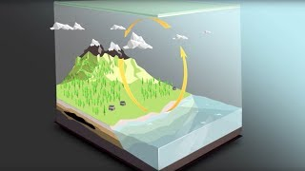
Video: The Carbon Cycle

Slide 8
Carbon Source
(or “Flux”)
Carbon Sink
(or “Reservoir”)
substances or places that produce or release CO₂ or other forms of carbon
areas or organisms that absorb, dissolve, or store carbon for later use by other things

Slide 9
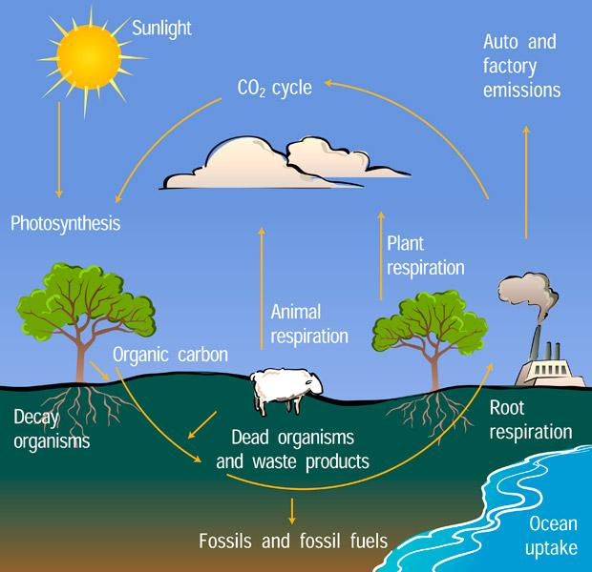
Identify the carbon SOURCES and the carbon SINKS in this diagram

Slide 10
Sources Sinks
-animal respiration -Oceans
-factory/ -All plant life
transportation -buried fossil
emissions (burning fuels
fossil fuels for
energy)
-waste products
in dumps
Which of these sources may not have existed 6000 years ago?

Slide 11
Carbon Sequestration
Sequester- to isolate or hide away
Carbon is taken out of the atmosphere and stored by certain organisms or geologic features.
Why is this helpful?
What are some organisms that provide this ECOSYSTEM SERVICE?

Slide 12
LET’S PLAY A GAME!
(Adapted by Jennifer Ceven, Grade 6 Science Teacher, from “The Incredible Journey,” Project Wet)

Slide 13
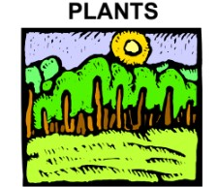
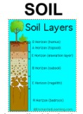
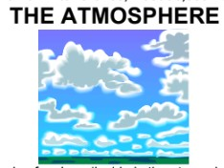
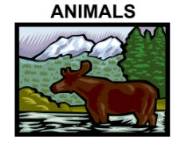
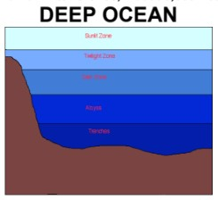
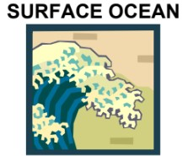
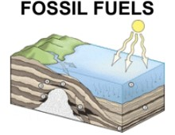
Go to your assigned start station!
No one starts here

Slide 14
ROUND 1: 6000 years ago
Let’s begin!
Indicate where you are now in the first space on your worksheet.
Roll the dice!
Read the station card to find out what happens to you! (Record on your sheet).
Go to the next station!

Slide 15
Go back to your seats to wait for round 2!
Predict: Round 2 will depict the carbon cycle as it is today. How will that be different than 6000 years ago?
Notes:
At this time, you can flip over or put up the new station signs.

Slide 16
ROUND 2: Present Day
Let’s begin!
Indicate where you are now in the first space on your worksheet.
Roll the dice!
Read the station card to find out what happens to you! (Record on your sheet).
Go to the next station!

Slide 17
Let’s sum up!
On your worksheets, answer:
In your journey, which carbon sources did you encounter? What were the carbon sinks?
What happens when the carbon sources are more productive than the carbon sinks?
Create a diagram and use arrows to show where YOU traveled as a carbon molecule, during Round 2.

Slide 18
GAO: Depiction of the Global Carbon Cycle Changes Over Time

