Slide 1
Ocean & Coastal Acidification
How can increased CO₂ alter water quality in the ocean?

Slide 2
Review:
The ocean absorbs CO₂.
Where does the CO₂ come from?
How does this help us?

Slide 3
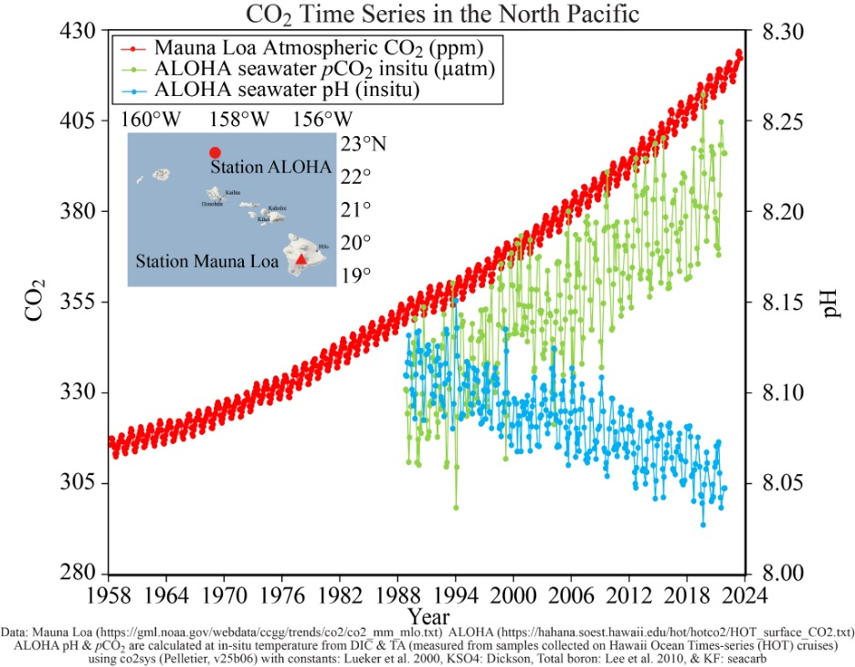
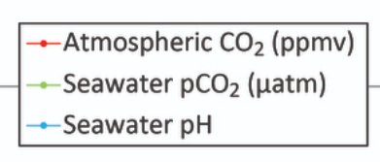
Notes:
First describe the x and y axes, and the key.
Then ask the students to write at least 2 or 3 facts they can extract from this graph.
Guided scaffolding questions on next slide.
Image credit:
https://pmel.noaa.gov/co2/file/Hawaii%20Carbon%20Dioxide%20Time-Series

Slide 4
How has atmospheric CO₂ changed over time?
How has the amount of CO₂ dissolved in seawater changed over time?
How has the pH of the ocean changed over time?
Extrapolate:
What is the relationship between CO₂ and ocean pH?
Notes:
First describe the x and y axes, and the key.
Then ask the students to write at least 2 or 3 facts they can extract from this graph.
Use the scaffolding questions if desired.
Image credit:
https://pmel.noaa.gov/co2/file/Hawaii%20Carbon%20Dioxide%20Time-Series

Slide 5
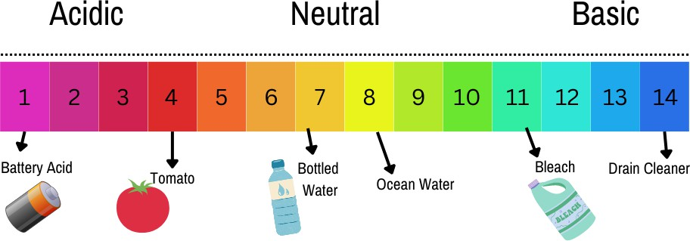
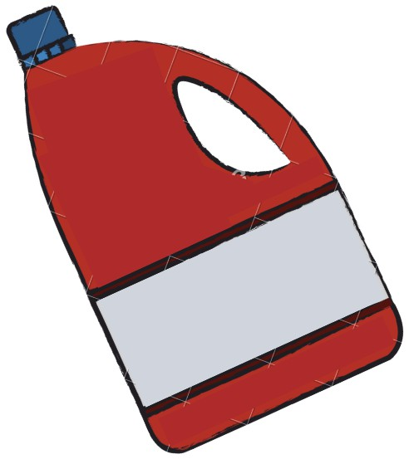

What is pH and why does it matter?
What is an example of a neutral substance?
Acids?
Bases?
Notes:
Give students an opportunity to share what they already know about pH.
Emphasize that ocean water is naturally basic/alkaline

Slide 6
What is pH and why does it matter?
pH describes how much free H⁺ or OH⁻ are found in a substance
Acids: More H⁺ ions ←--------→ Bases: more OH⁻ ions
It matters because it affects how the substance reacts with other compounds.

Slide 7
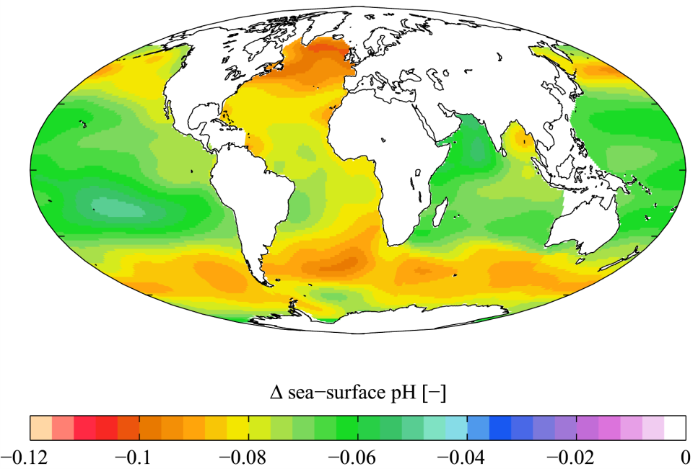
Historical changes in annual mean sea surface pH between 1700s and 1990s.
©2009 Plumbago
Notes:
First, explain the key on the false color image: the colors indicate how much the pH has changed since the 1700s.
Ask students: where do you see the most change? The least? Why do you think that is?
Guide students to recall the graphs in these slides.
Image credit:
https://www.biointeractive.org/classroom-resources/ocean-acidification

Slide 8
Ocean Acidification
As you watch the video clip, consider the following questions:
How can CO₂ create change in the ocean’s pH?
How does carbonic acid create changes in ocean ecosystems?
Notes:
https://www.youtube.com/watch?v=kxPwbhFeZSw&t=46s

Slide 9
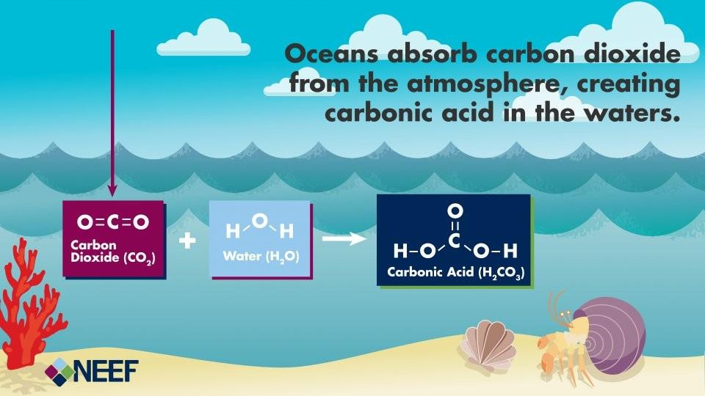
How can CO₂ create change in the ocean’s pH?
Notes:
Image credit:
https://www.neefusa.org/resource/ocean-acidification-infographic

Slide 10
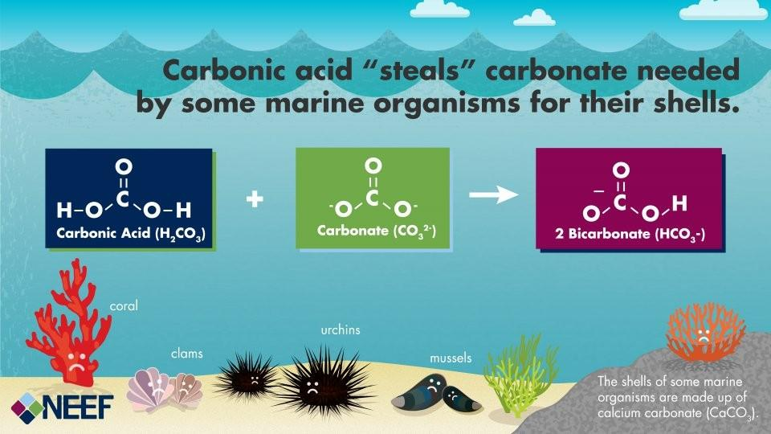
How does carbonic acid create changes in ocean ecosystems?
Notes:
Image credit:
https://www.neefusa.org/resource/ocean-acidification-infographic

Slide 11
Check for understanding!
Sort the following statements into the correct order:
Carbonic acid lowers the pH of the ocean water.
Carbon dioxide is absorbed by the ocean.
Less carbonate is available for marine organisms to use to create body structures
Carbon dioxide molecules bond with water molecules to create carbonic acid.
Carbonic acid bonds with carbonate in the ocean.

Slide 12
Check for understanding!
Were you correct?
Carbon dioxide is absorbed by the ocean.
Carbon dioxide molecules bond with water molecules to create carbonic acid.
Carbonic acid lowers the pH of the ocean water.
Carbonic acid bonds with carbonate in the ocean.
Less carbonate is available for marine organisms to use to create body structures

