Slide 1
Aim: How can we design & conduct an experiment to demonstrate whether CO₂ changes the pH of ocean water?
Do Now:
What are some sources of CO₂ in our oceans?
What substance is formed when CO₂ combines with water?
Notes:
Review from previous notes.
The next 2 slides will allow you to review the important concepts for today’s lesson.

Slide 2
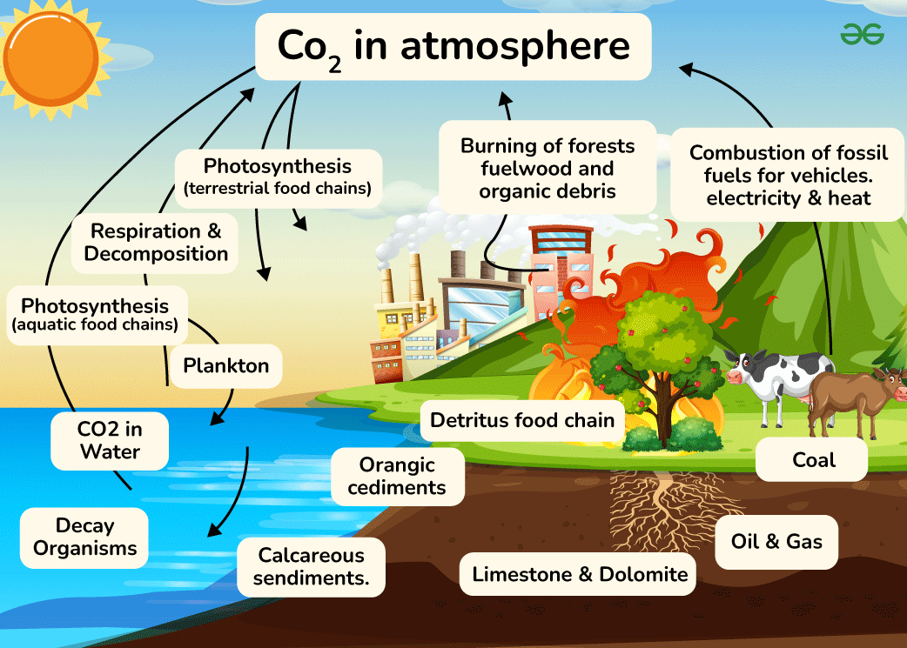
https://www.geeksforgeeks.org/carbon-cycle-diagram/
Notes:
Image credit:
https://media.geeksforgeeks.org/wp-content/uploads/20240402104049/Diagram-of-carbon-cycle.png

Slide 3
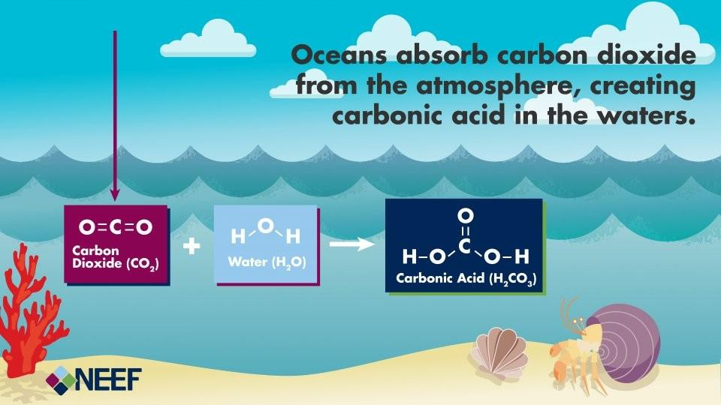
How can CO₂ create change in the ocean’s pH?
Notes:
Image credit:
https://www.neefusa.org/resource/ocean-acidification-infographic

Slide 4
Goals
Today we will see if it’s true:
Does adding CO₂ to water really change its pH?
Brainstorm:
How would you set up this experiment?
What materials do you think we need to perform this experiment?
Make a list with your partner, see if you can think of everything we might need!
Notes:
Give the students time to think about how they would set up this experiment.
Ideally they can draw a sketch of their experimental set-up.
Allowing enough time for this step allows students to achieve NGSS Science and Engineering practices #2 and 3:
Developing and Using Models.
Planning and Carrying Out Investigations.
If you’ve already set out materials, have students think about how each will be used.

Slide 5
Materials
Water
A cup to hold the water
CO₂
  Where will we get CO₂ from?
    Our breath!
  How will we add it to the water?
    With a straw!
  How will we test if we really added CO₂?
    With an indicator solution!
CO₂ indicator: Bromothymol blue
pH indicator: test strips or homemade!
Notes:
Explain that while they may have a different experimental design than today’s experiment, it may still be perfectly valid, however, this is what we’ll need today.
As you reveal each material, ask the students if it made it to their list.
Ask the students as you proceed why each material is necessary.

Slide 6
Come get your materials!
Retrieve a lab sheet for each group member.
Take a tray of materials, but don’t get started yet!
Notes:
If you’ve already set out materials, skip!

Slide 7
Read the introductory questions on your lab sheet.
Let’s watch this video, and answer question 1.
Watch your teacher, and answer question 2.
Now we’ll watch this video and answer questions 3 & 4.
Notes:
Demonstrating step 2, in which you blow bubbles into a cup containing water and bromothymol blue is necessary, so students can observe how long they should blow bubbles, and how gently, so as not to make a mess.

Slide 8
Procedure
You will need an experimental and a control set up. How will they differ?
How will you add CO₂ to the water?
How will you determine if CO₂ was added to the water?
How will you determine the pH of the water?
What results would indicate that CO₂ does change the pH of water?
Notes:
This section on their lab sheets gives students time to organize their thoughts, and actively plan their next few steps.

Slide 9


Control vs Experimental Group
Control
Experimental
Add water
Add water
2. Add 5 drops Bromothymol blue
2. Add 5 drops Bromothymol blue
3. ADD CO₂.
(blow bubbles until color changes)
3. DON’T add CO₂.
4. Test pH
4. Test pH

Slide 10
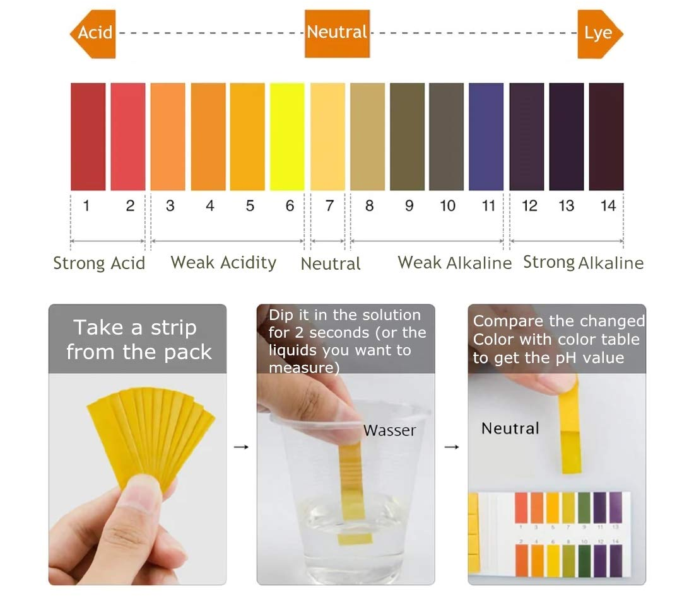
Reading pH test strips
Notes:
Teacher will have to insert correct instructions depending on their pH indicator.

Slide 11
Results
 | Control (no CO₂ added) | Experimental (CO₂ added)
pH

Slide 12
Conclusions
Did the addition of CO₂ impact the pH of your water sample?
In this experiment we blew bubbles into the water. In the real ocean system, how is CO₂ added to the water?
Why might a change in pH negatively impact ocean ecology?

