Slide 1
Coastal Acidification

Slide 2
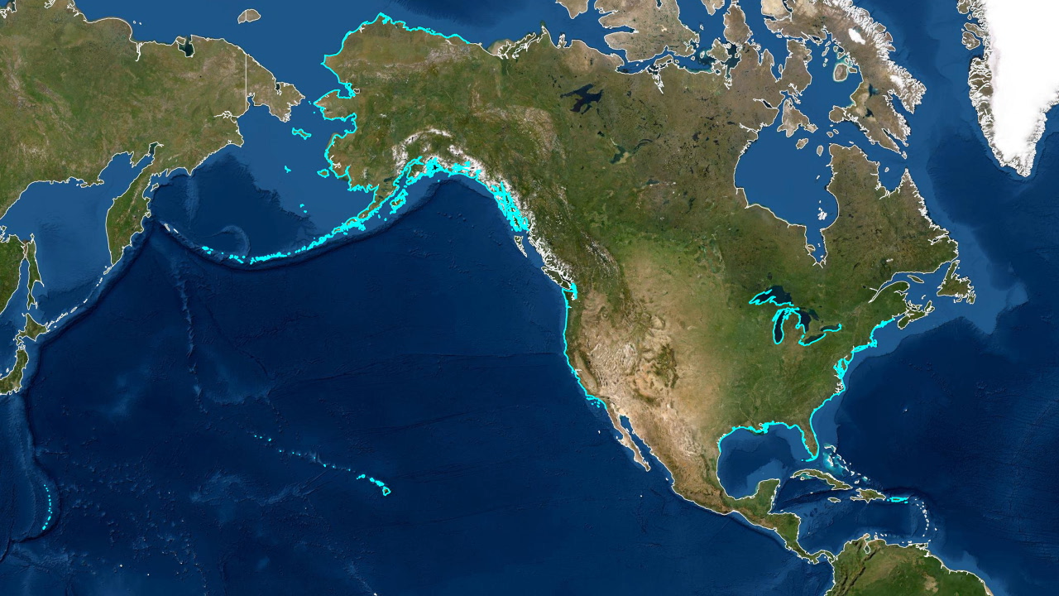
Aim: How does coastal acidification compare to acidification in the open ocean?
Do Now:
Where do you think ocean acidification is a bigger problem:
Open ocean or in coastal waters? Why?
Notes:
Use the map to remind students what is meant by open ocean vs. coastal waters.
Image credit:
https://www.usgs.gov/media/images/map-us-coastlines

Slide 3
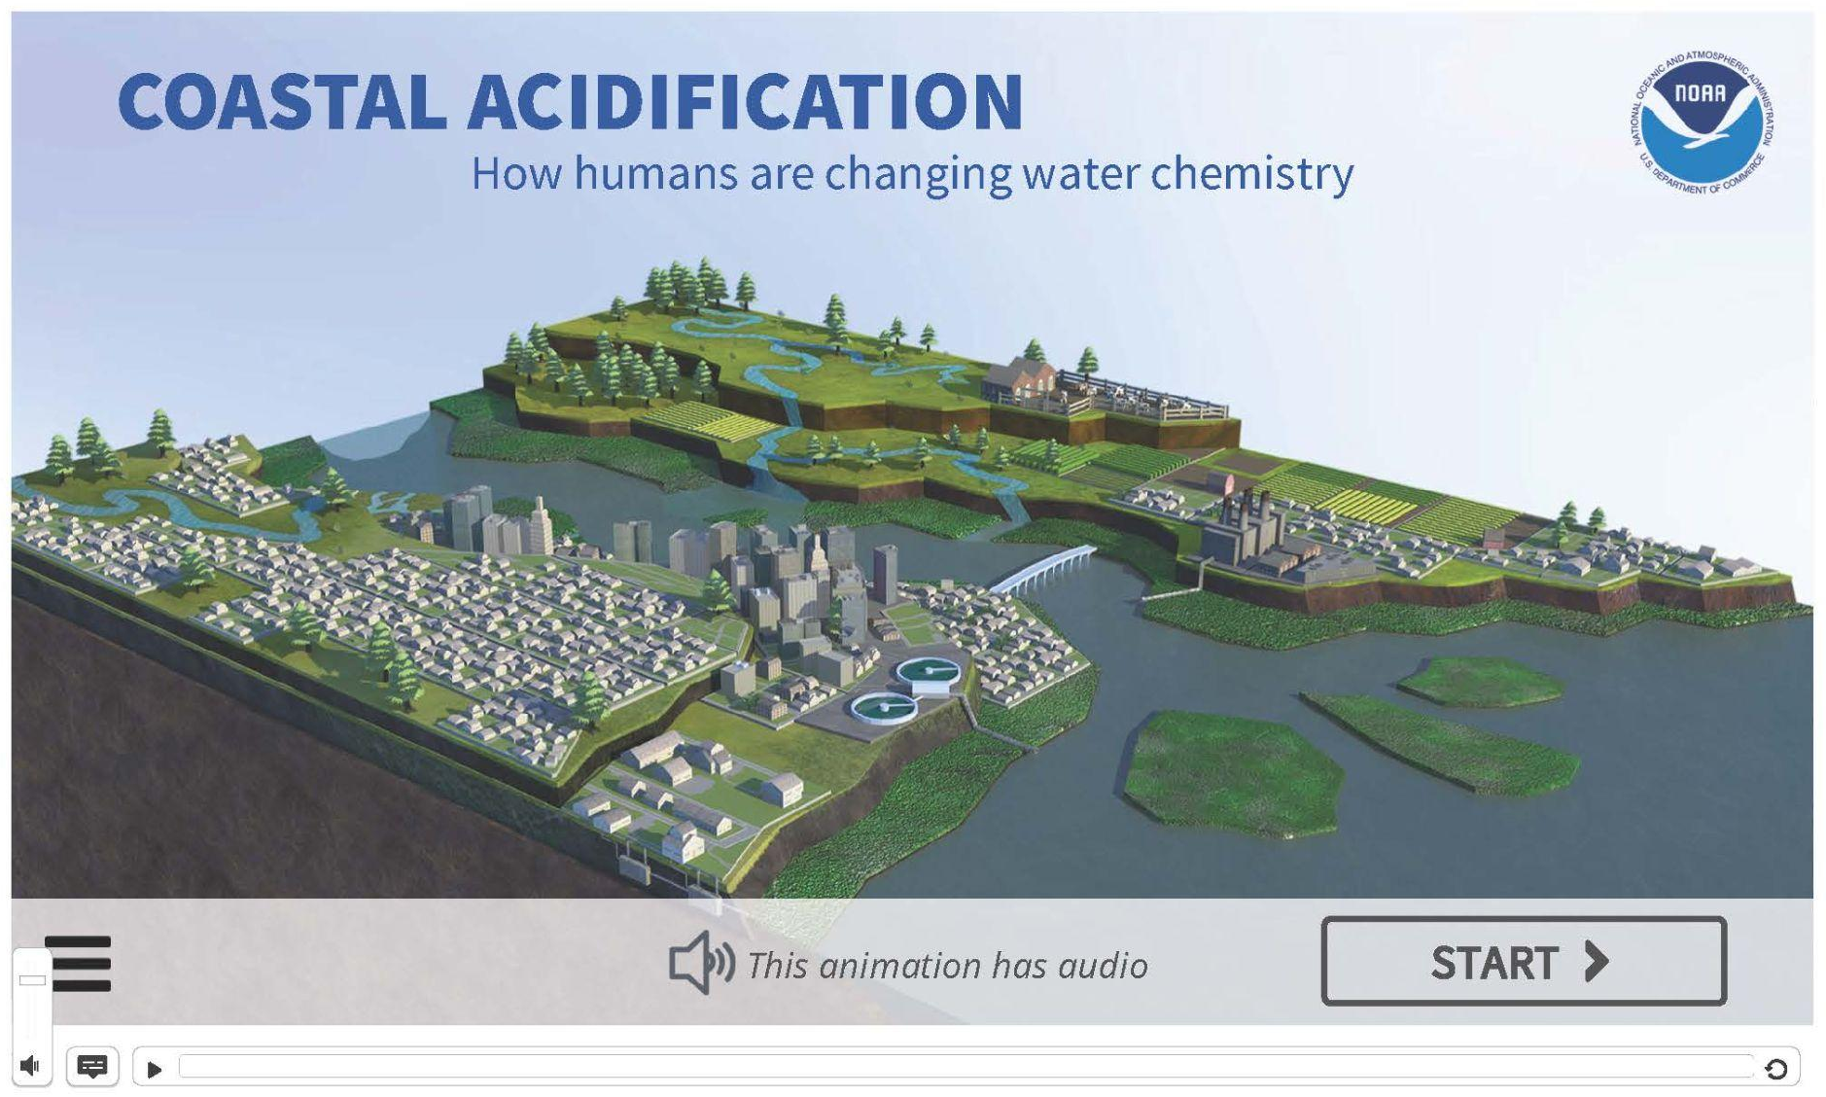

Slide 4
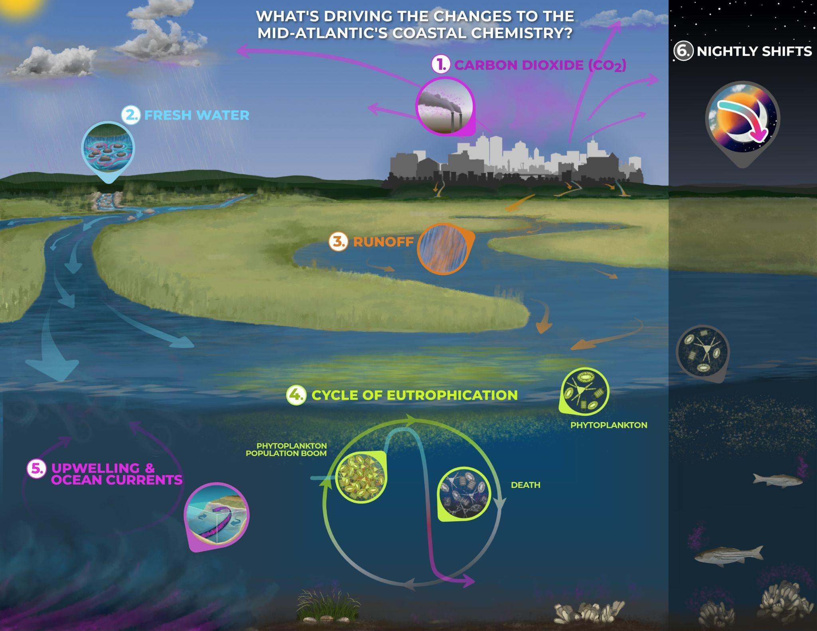
Read about the factor you’ve been assigned (#1-6). In your notebook, write a one sentence summary about how this factor impacts coastal pH.
When instructed to do so, you will take turns sharing the information with your group.

Slide 5
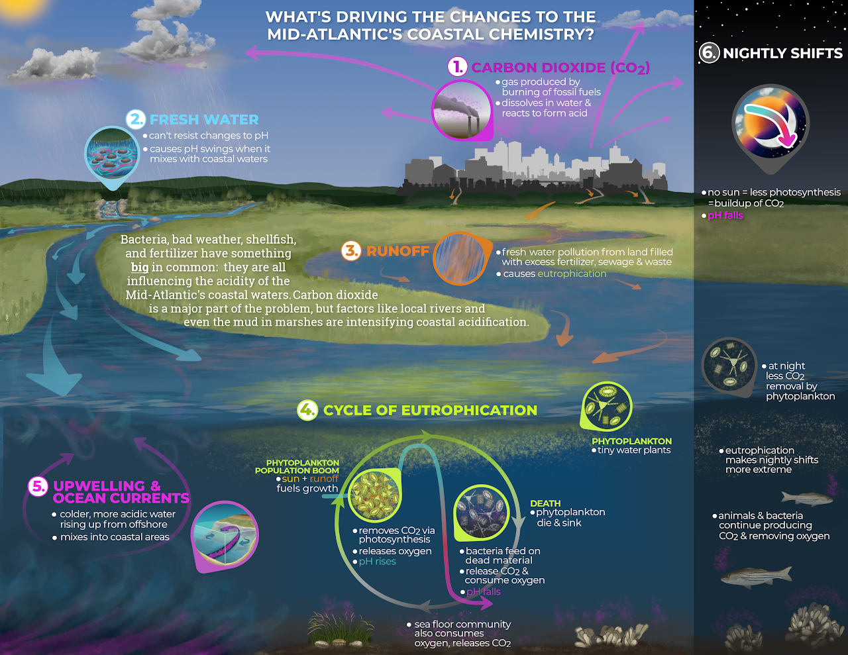

Slide 6
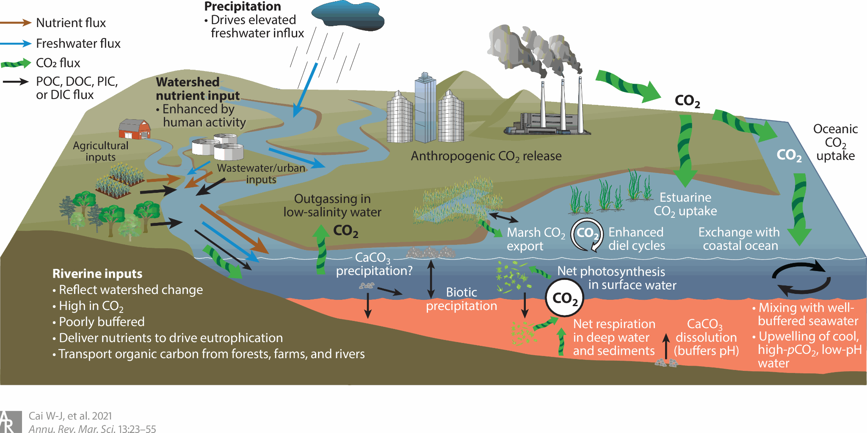
What additional factors cause changes in pH of coastal waters?
Notes:
Image credit:
Cai, Wei-Jun, Richard A. Feely, Jeremy M. Testa, Ming Li, Wiley Evans, Simone R. Alin, Yuan-Yuan Xu, Greg Pelletier, Anise Ahmed, Dana J. Greeley, Jan A. Newton and Nina Bednaršek. 2021. Natural and Anthropogenic Drivers of Acidification in Large Estuaries. Annual Review of Marine Science. 13:23-55. https://doi.org/10.1146/annurev-marine-010419-011004

Slide 7
Coastal Acidification:
nearshore changes in pH
Caused by:
Nutrient runoff
Upwelling
Precipitation
Increased atmospheric CO₂ absorption (just like open ocean).

Slide 8
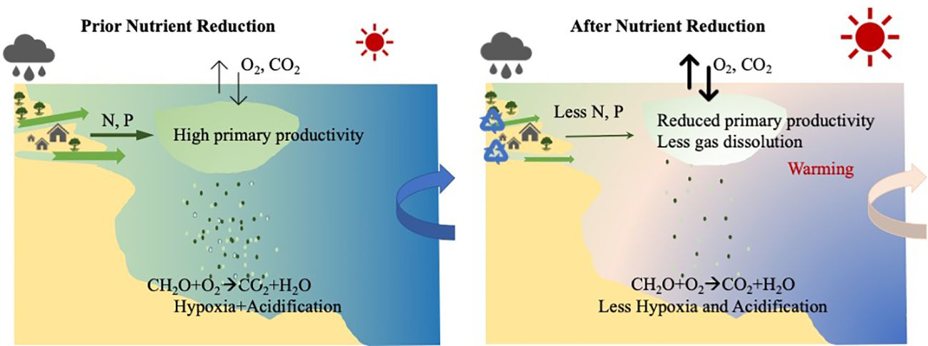
Nutrient Runoff and Coastal pH
Notes:
Wang, H., Codiga, D. L., Stoffel, H., Oviatt, C., Huizenga, K., & Grear, J. (2024). Effect of nutrient reductions on dissolved oxygen and pH: A case study of Narragansett bay. Frontiers in Marine Science, 11. https://doi.org/10.3389/fmars.2024.1374873

Slide 9
Nutrient runoff and Coastal pH
Nutrients from sewage, fertilizer and other sources flow into nearshore habitats.
These extra nutrients cause algal blooms.
As the algae die, they release CO₂ into the water, increasing acidification locally.

Slide 10
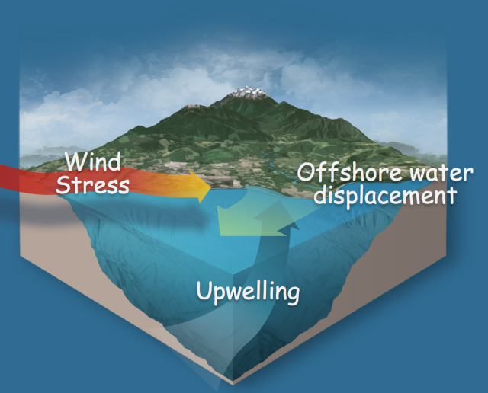
Upwelling and Coastal pH
Due to earth’s rotation
Brings high CO₂, low pH, low Ω, low O₂, water to the surface
Notes:
Image credit:
https://apps.ecology.wa.gov/publications/publications/1201016.pdf

Slide 11
Upwelling and Coastal pH
Upwelling describes deep, cold water rising toward the surface, usually at coastlines.
This water is high in CO₂ and has a low pH.
As it mixes, it increases the acidity of coastal waters.
Due to earth’s rotation
Brings high CO₂, low pH, low Ω, low O₂, water to the surface
Notes:
Image credit:
https://apps.ecology.wa.gov/publications/publications/1201016.pdf

Slide 12
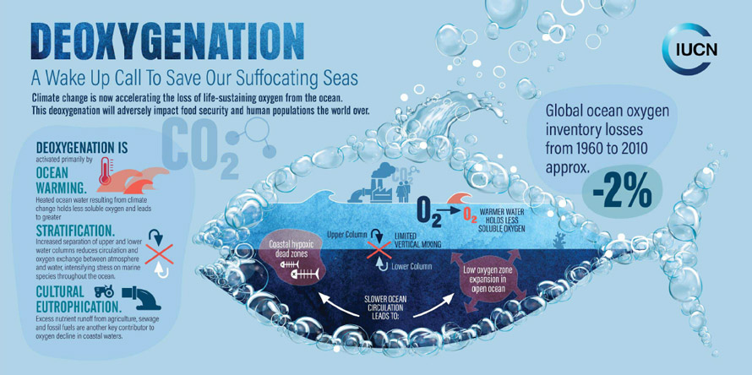
Hypoxia and Coastal pH
Hypoxia: decreased oxygen in coastal waters can cause organisms to die
As dead organisms decay, CO₂ is released, increasing acidification
Hypoxia is caused by:
Warming seas because warmer water holds less (soluble) oxygen,
Stratification as limited vertical mixing reduces oxygen exchange between the ocean and the atmosphere, and
Eutrophication in coastal areas.
Notes:
Hypoxia describes low oxygen content.
This is caused by:
Warming surface temperatures which prevent mixing of atmospheric oxygen into the ocean waters.
Eutrophication.
Hypoxia is a costressor with acidification
Image credit:
https://marine.copernicus.eu/news/ocean-deoxygenation-and-alarming-consequences

Slide 13
Discussion
What are the societal implications of coastal acidification, including its potential impacts on local economies (e.g., fishing industries) and coastal ecosystems?

