Slide 1
This lesson is adapted from
Calcifiers and Non-Calcifiers: Impacts of Ocean Acidification on Marine Organisms
from Education | Office National Marine Sanctuaries

Slide 2
Biological Impacts of Ocean Acidification

Slide 3
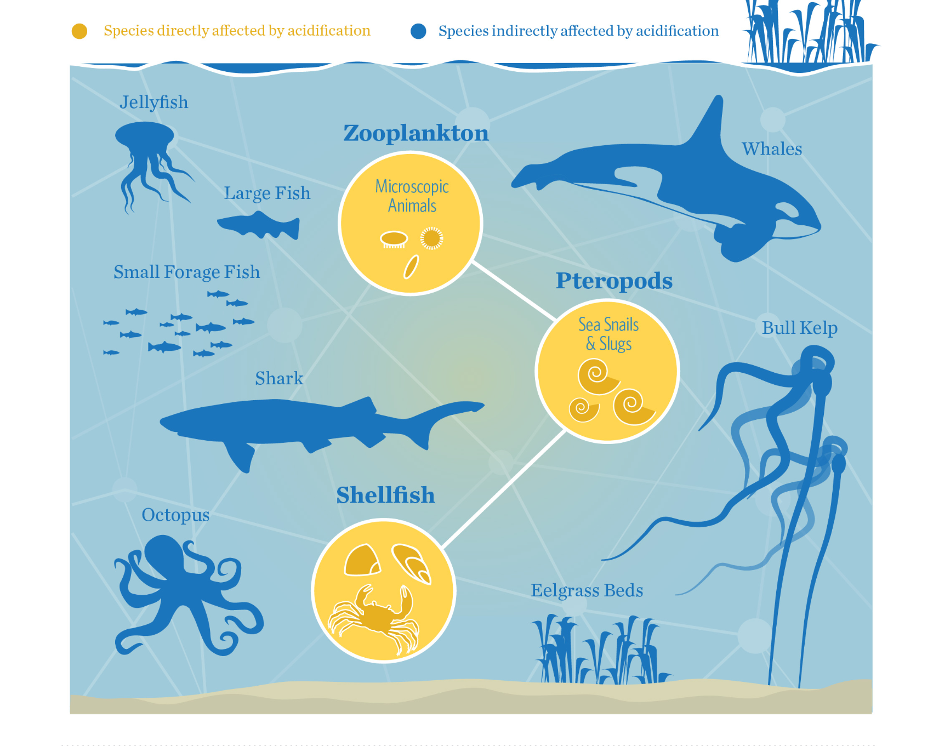
Aim: How are different species impacted by Ocean Acidification?
Do Now:
In this diagram, the organisms highlighted in yellow are directly affected by ocean acidification, and the those in blue are indirectly affected.
What is meant by directly and indirectly?
Why are zooplankton, pteropods, and shellfish directly impacted by OA?
Notes:
Example from the Pacific Northwest
Image credit
https://www.washingtonnature.org/oceanacidification

Slide 4
Infer:
Pteropods, zooplankton, and shellfish are referred to as “calcifiers”.
What might this mean?
Sorting Activity:
With a partner, sort the cards into two piles:
“Calcifiers” and “Non-calcifiers”

Slide 5
Interpreting Data
Skim the data table describing the biological impacts of ocean acidification.
With your partner, determine what the color-coding in the data tables indicate.
Red=
Orange=
Yellow=
Green=
Grey=
Notes:
Image credit:
Kroeker KJ, Kordas RL, Crim R, Hendriks IE, Ramajo L, Singh GS, Duarte CM, Gattuso JP. Impacts of ocean acidification on marine organisms: quantifying sensitivities and interaction with warming. Glob Chang Biol. 2013 Jun;19(6):1884-96. doi: 10.1111/gcb.12179. Epub 2013 Apr 3. PMID: 23505245; PMCID: PMC3664023.

Slide 6
Interpreting Data
Red= OA has a negative impact on this parameter
Orange= OA has a minor negative impact on this parameter
Yellow= OA has no impact on this parameter
Green= OA has a positive impact on this parameter
Grey= OA has not been studied for this parameter
Notes:
Image credit:
Kroeker KJ, Kordas RL, Crim R, Hendriks IE, Ramajo L, Singh GS, Duarte CM, Gattuso JP. Impacts of ocean acidification on marine organisms: quantifying sensitivities and interaction with warming. Glob Chang Biol. 2013 Jun;19(6):1884-96. doi: 10.1111/gcb.12179. Epub 2013 Apr 3. PMID: 23505245; PMCID: PMC3664023.

Slide 7
Use the data table to answer the questions on your worksheet
Notes:
Image credit:
Kroeker KJ, Kordas RL, Crim R, Hendriks IE, Ramajo L, Singh GS, Duarte CM, Gattuso JP. Impacts of ocean acidification on marine organisms: quantifying sensitivities and interaction with warming. Glob Chang Biol. 2013 Jun;19(6):1884-96. doi: 10.1111/gcb.12179. Epub 2013 Apr 3. PMID: 23505245; PMCID: PMC3664023.

Slide 8
Concept Mapping
With your partner, create a concept map showing the interrelationships between at least 5 of the organisms from the data table.
You will use the information from the data table as well as your own research.

Slide 9
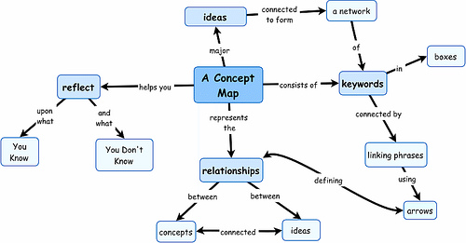
Components of a good concept map:
Labeled images (nodes)
Labelled connectors

Slide 10
Stuck?
Start by creating a food web between at least 5 of the organisms. Highlight those directly affected by ocean acidification in yellow, and those indirectly affected in blue.

