Slide 1
Aim: How can we analyze data to make conclusions about ocean acidification?
Do Now:
What happens to the pH of water when CO₂ concentration increases? Why?

Slide 2
Can you represent your do now answer as a graph?
pH
CO₂ concentration
As CO₂ increases, pH __________.
decreases

Slide 3
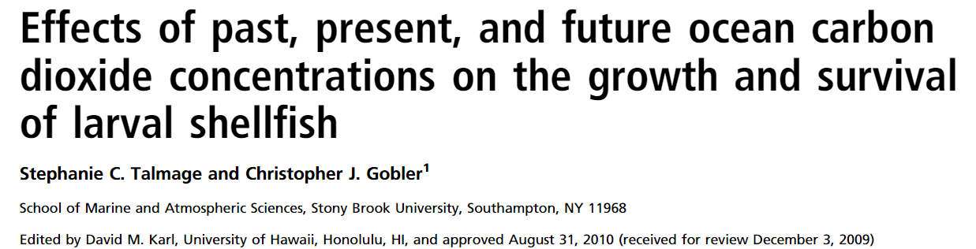
Today you will analyze real scientific data!

Slide 4
Instructions
Students will work in groups of 4.
There are a total of 8 data tables. Each student will select two, and answer the analysis questions for each.
As a group, students will work together to answer the final analysis questions.

Slide 5
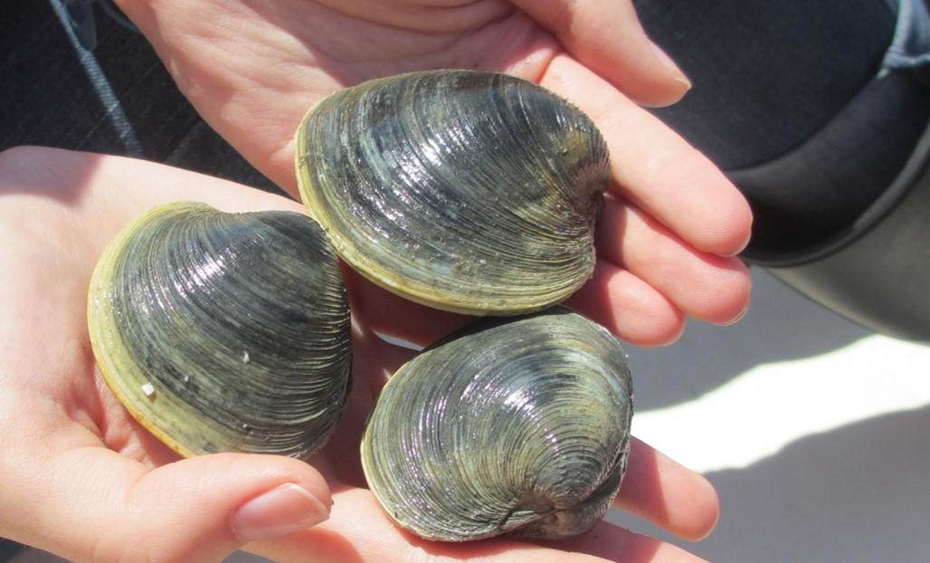
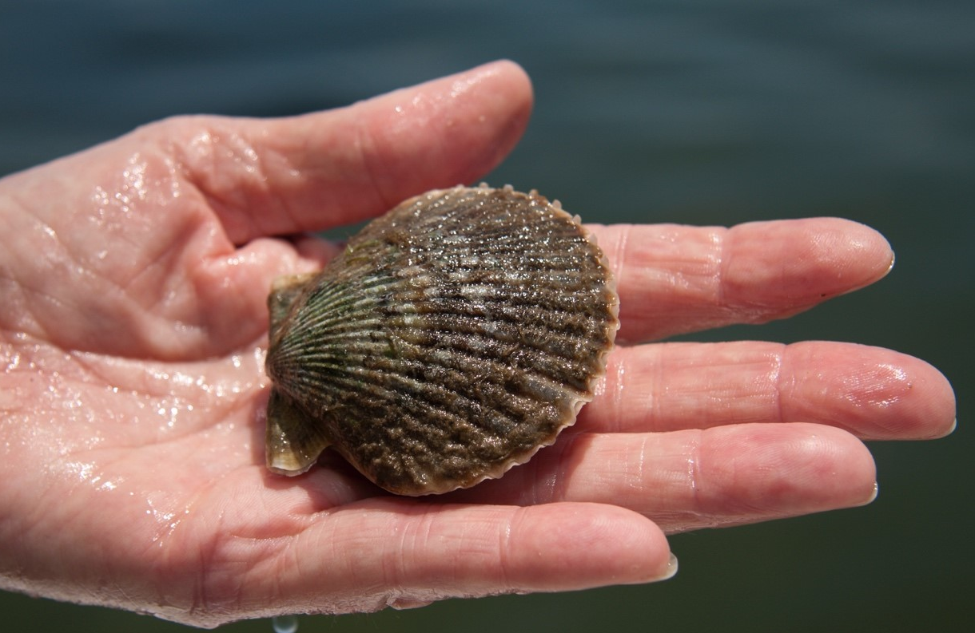
Northern Quahog
Mercenaria mercenaria
Bay Scallop
Argopecten irradians

Slide 6
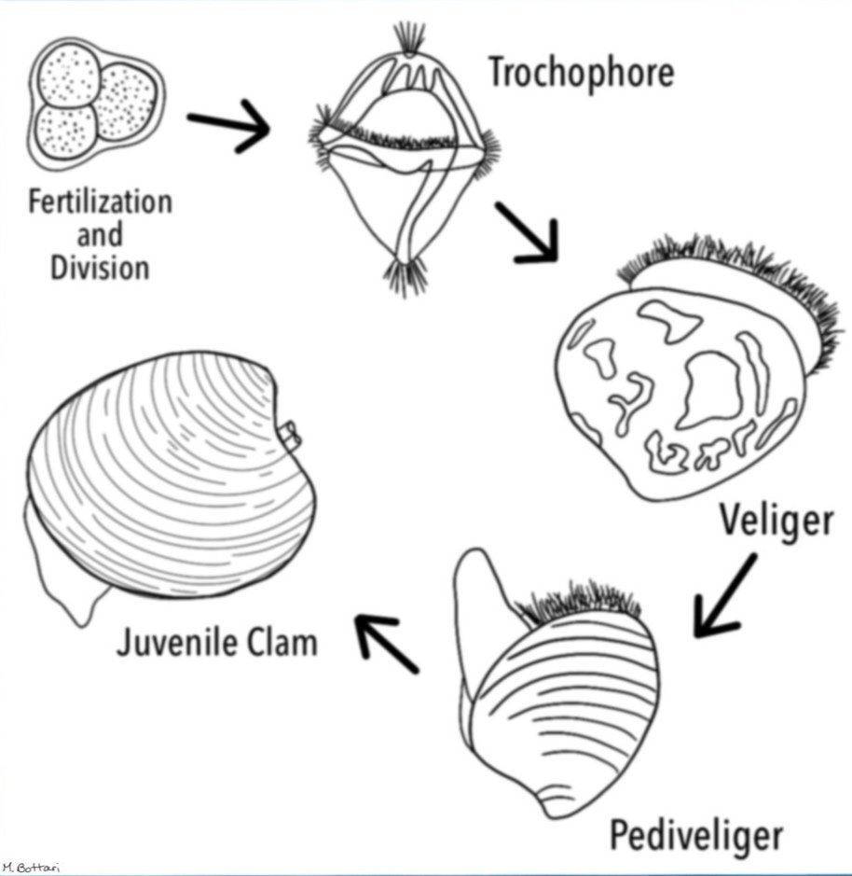
Bivalve Life Cycle
Veliger- free-swimming, planktonic larval stage
Pediveliger- foot has developed, used for crawling and attachment to a substrate
Metamorphosed- has reached its adult form

Slide 7
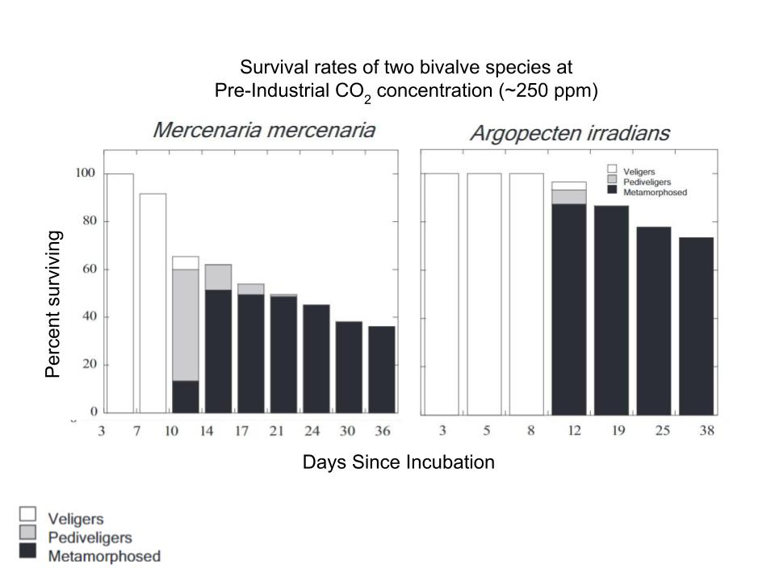
Data Table
1

Slide 8
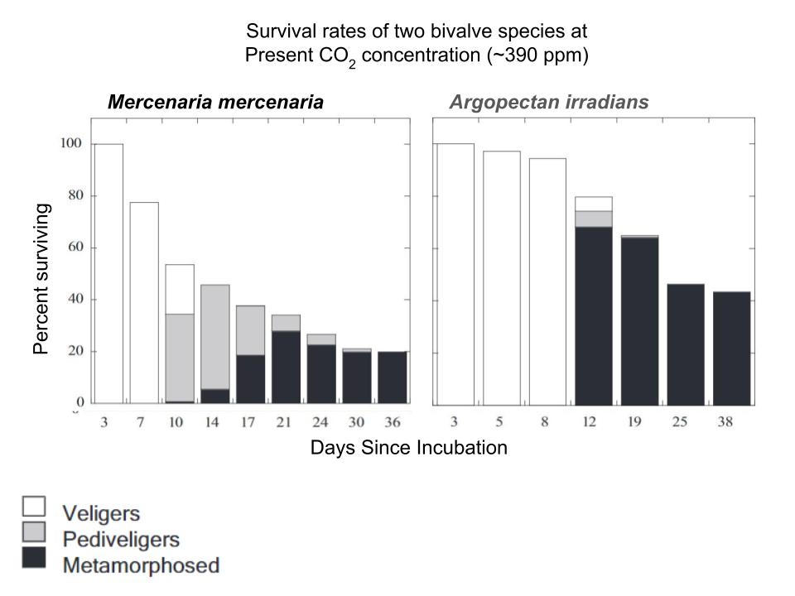
Data Table
2
Notes:
Mention that “present CO2 concentration” refers to present at the time of the study (2010) not present day

Slide 9
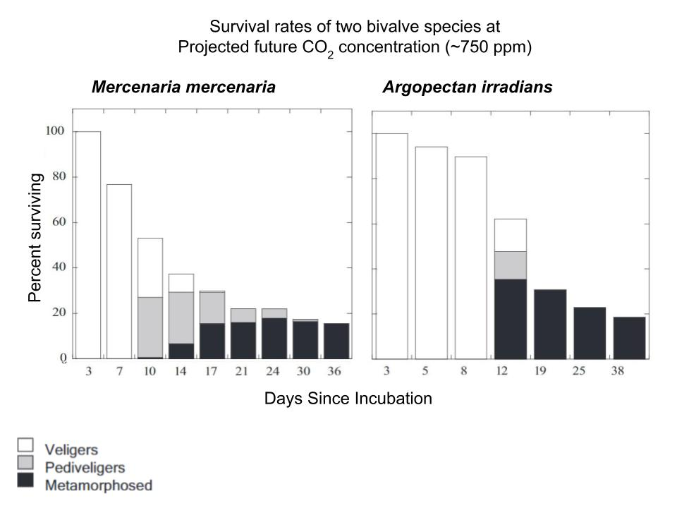
Data Table
3

Slide 10
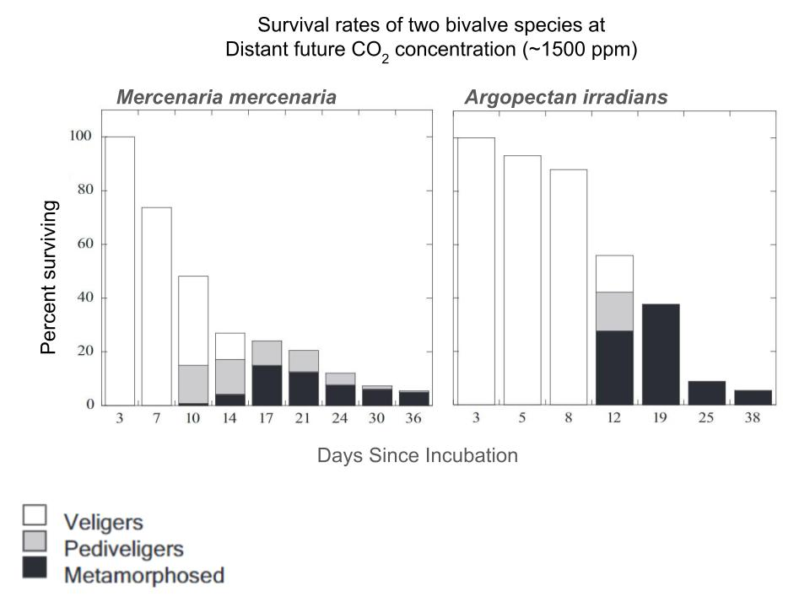
Data Table
4

Slide 11
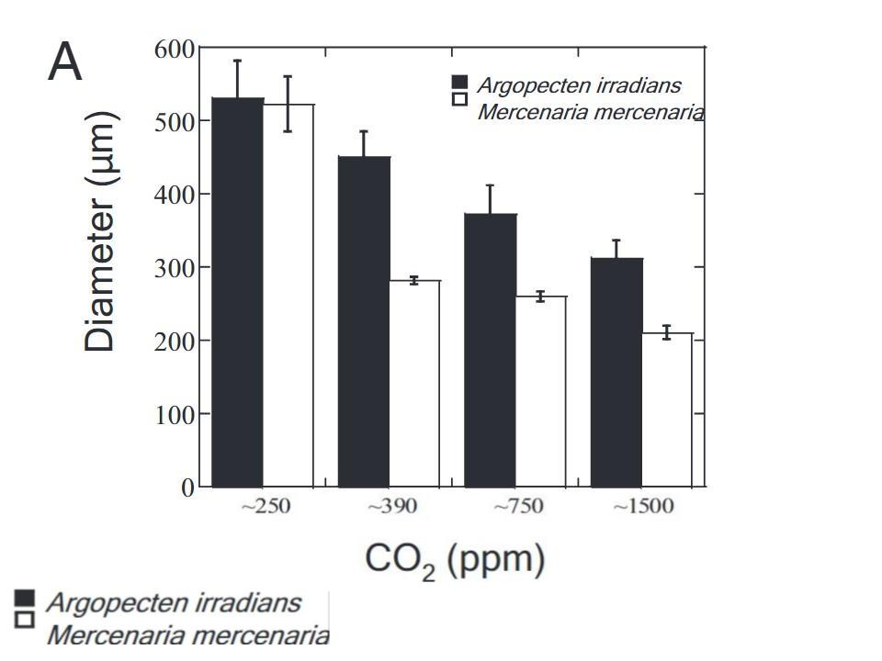
Data Table
5

Slide 12
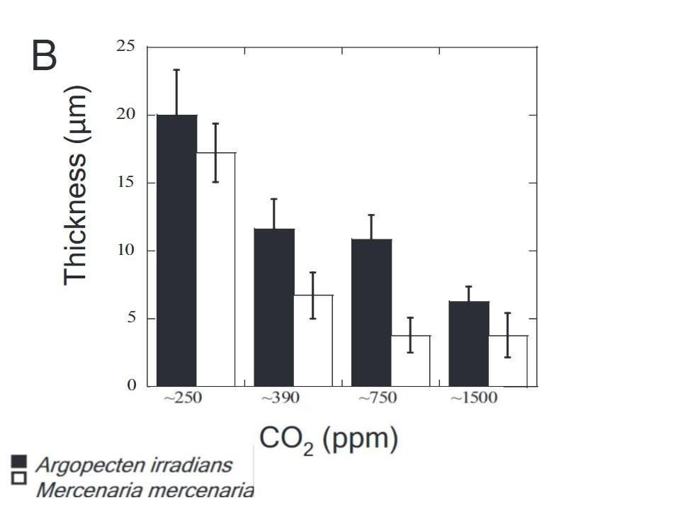
Data Table
6

Slide 13
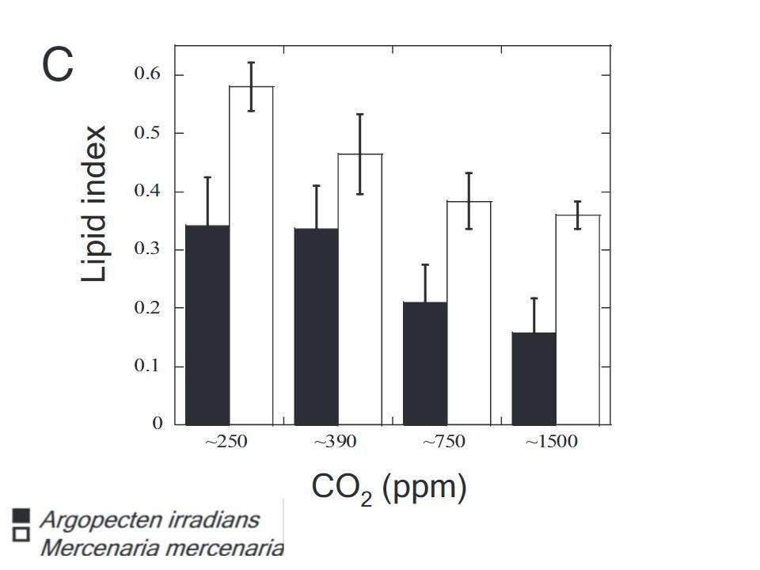
Data Table
7

Slide 14
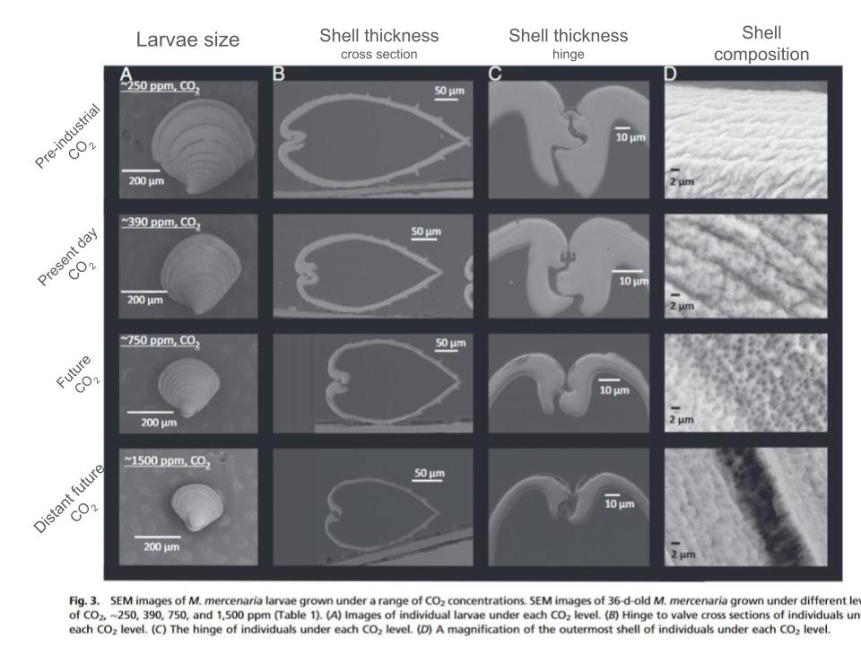
Data Table
8

