Slide 1
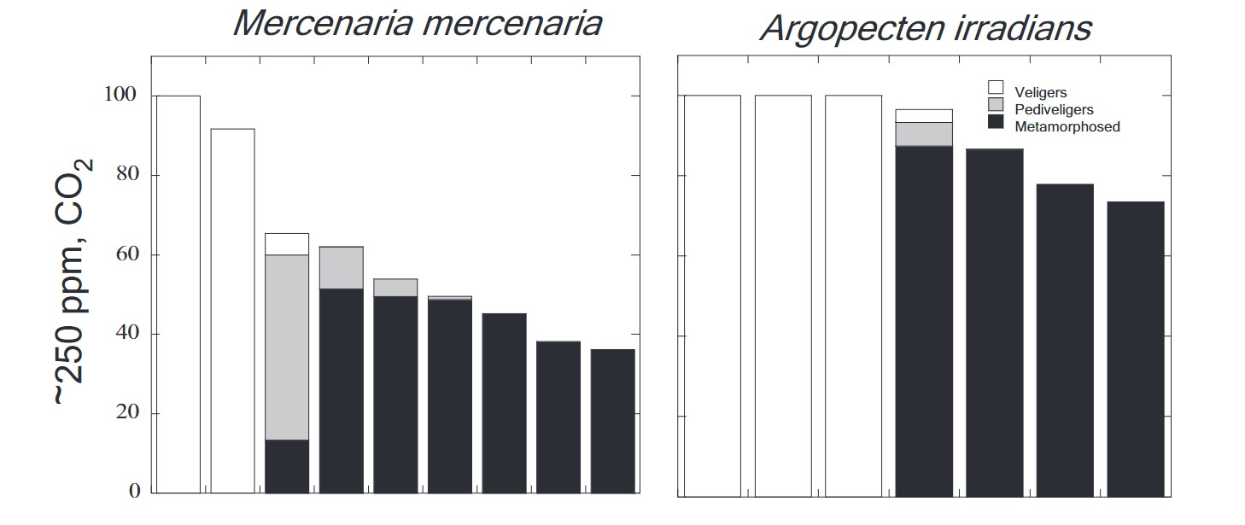
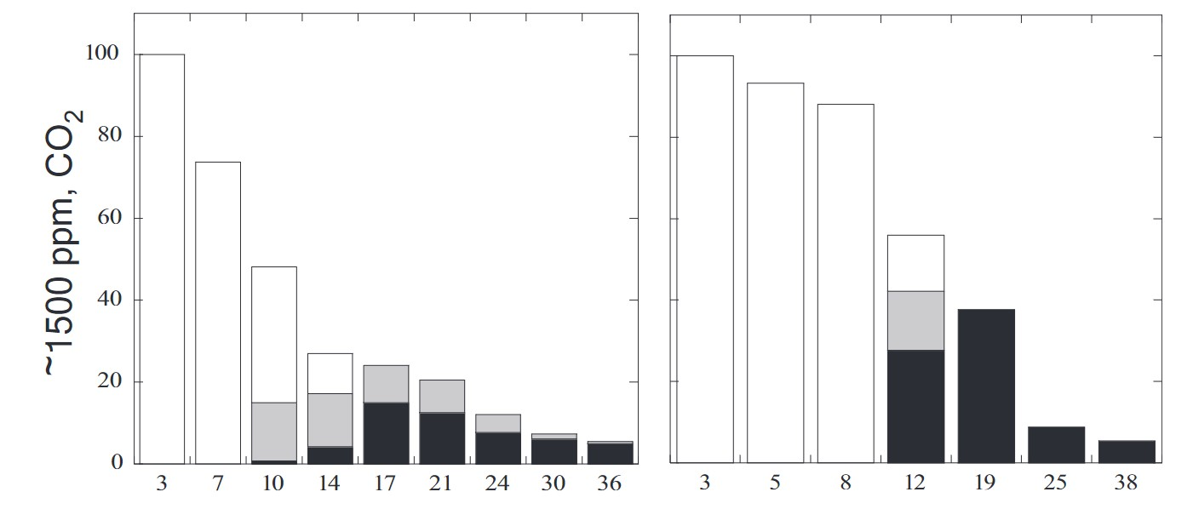
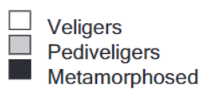
Survival rates of two bivalve species at
Pre-Industrial CO₂ concentration (~250 ppm)
Percent surviving
Days Since Incubation
Notes:
These are the same data tables found on the student worksheets. This slideshow may be used for display for teacher modelling, etc..

Slide 2
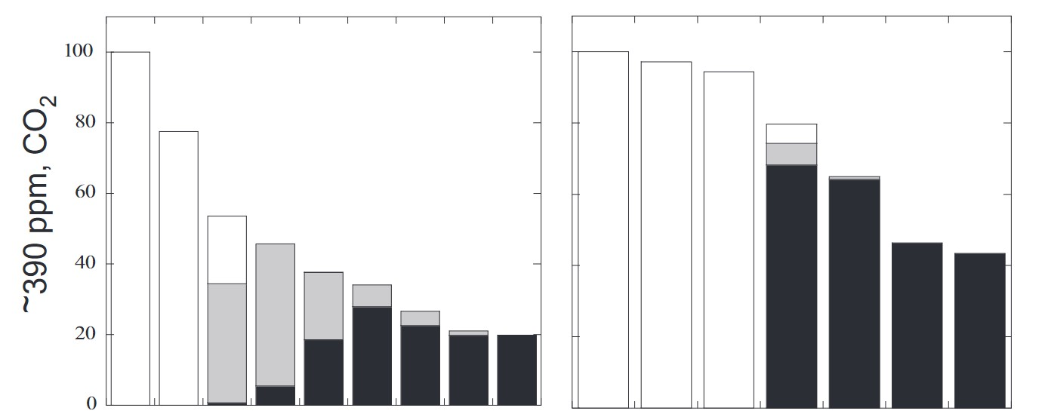
Survival rates of two bivalve species at
Present CO₂ concentration (~390 ppm)
Mercenaria mercenaria
Argopecten irradians
Percent surviving
Days Since Incubation
Notes:
These are the same data tables found on the student worksheets. This slideshow may be used for display for teacher modelling, etc..

Slide 3
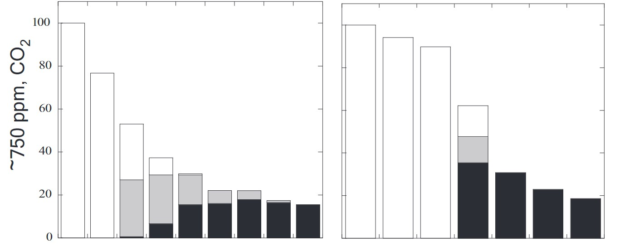
Survival rates of two bivalve species at
Projected future CO₂ concentration (~750 ppm)
Mercenaria mercenaria
Argopectan irradians
Percent surviving
Days Since Incubation
Notes:
These are the same data tables found on the student worksheets. This slideshow may be used for display for teacher modelling, etc..

Slide 4
Survival rates of two bivalve species at
Distant future CO₂ concentration (~1500 ppm)
Mercenaria mercenaria
Argopectan irradians
Percent surviving
Days Since Incubation
Notes:
These are the same data tables found on the student worksheets. This slideshow may be used for display for teacher modelling, etc..

Slide 5
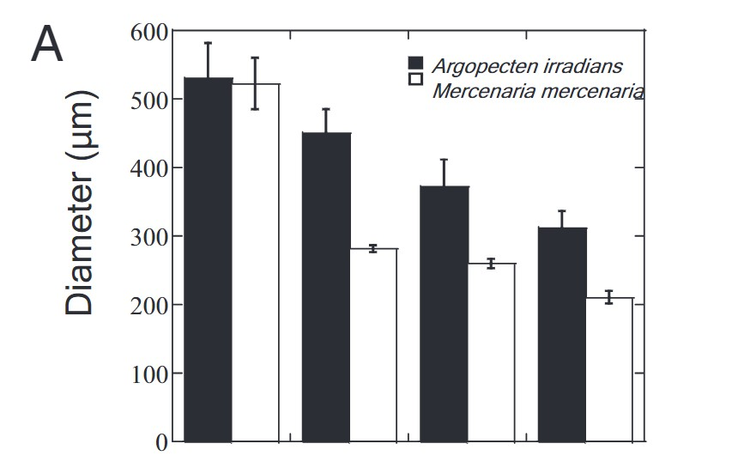
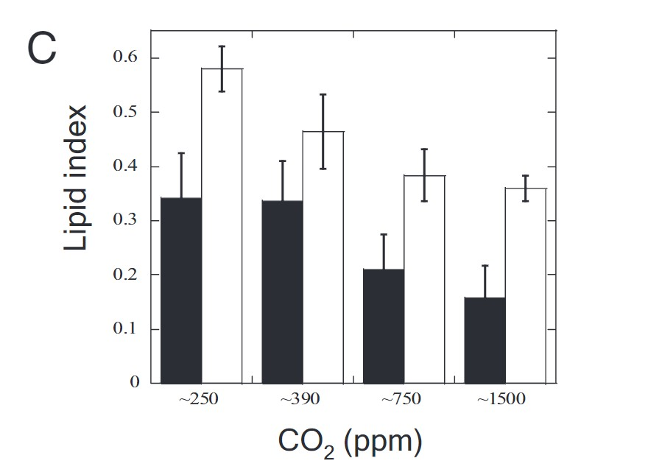
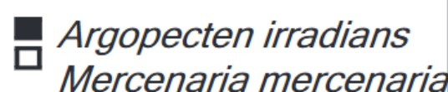
Notes:
These are the same data tables found on the student worksheets. This slideshow may be used for display for teacher modelling, etc..

Slide 6
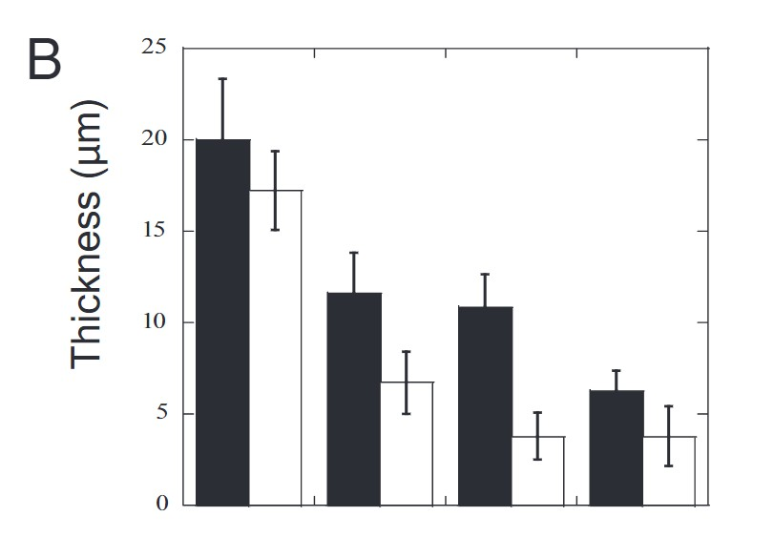
Notes:
These are the same data tables found on the student worksheets. This slideshow may be used for display for teacher modelling, etc..

Slide 7
Notes:
These are the same data tables found on the student worksheets. This slideshow may be used for display for teacher modelling, etc..

Slide 8
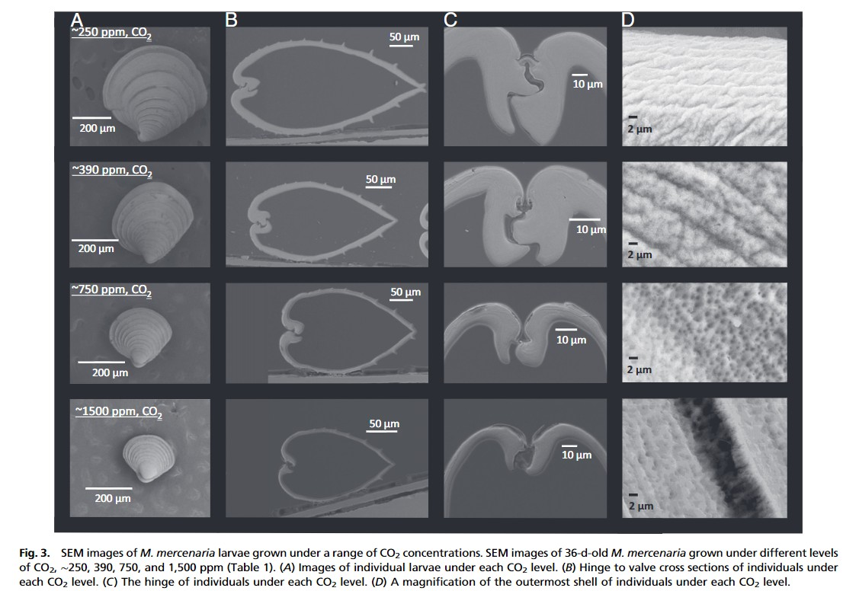
Larvae size
Shell thickness
cross section
Shell thickness
hinge
Shell composition
Pre-industrial
CO₂
Present day
CO₂
Future
CO₂
Distant future CO₂
Notes:
These are the same data tables found on the student worksheets. This slideshow may be used for display for teacher modelling, etc..

